Slide 1

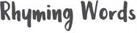


Slide 2
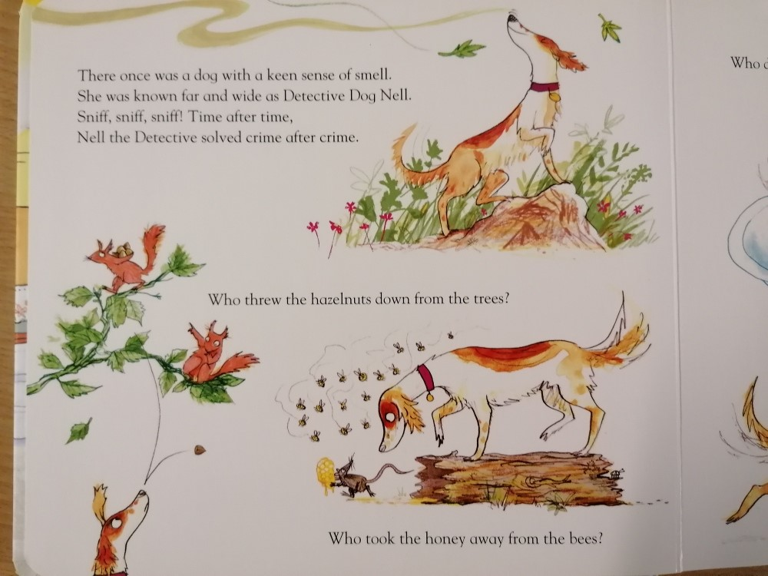


Slide 3
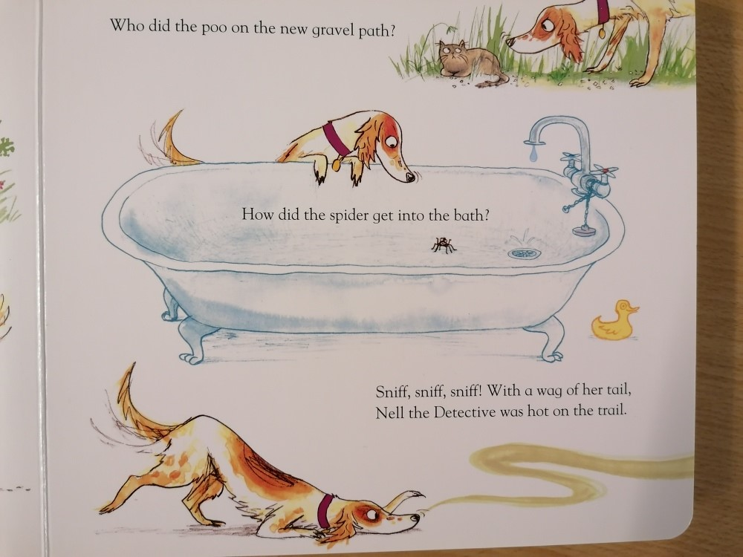


Slide 4
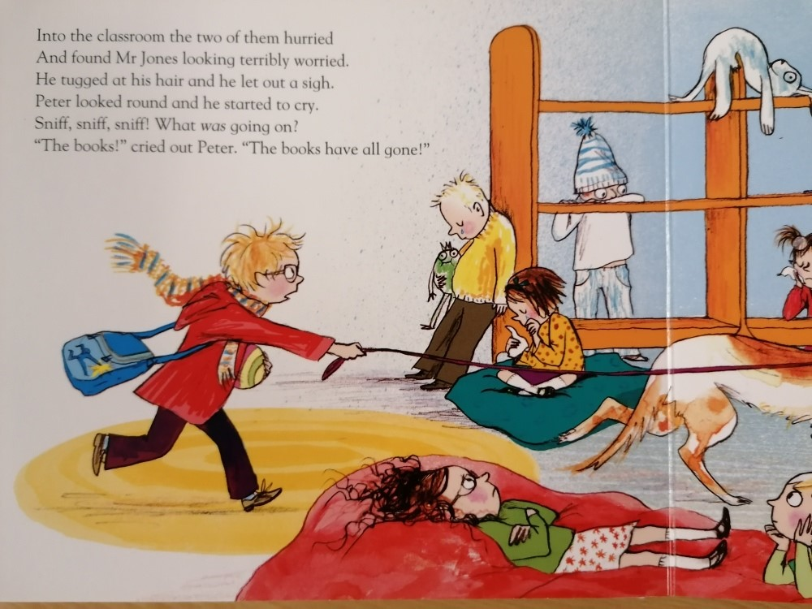


Slide 5
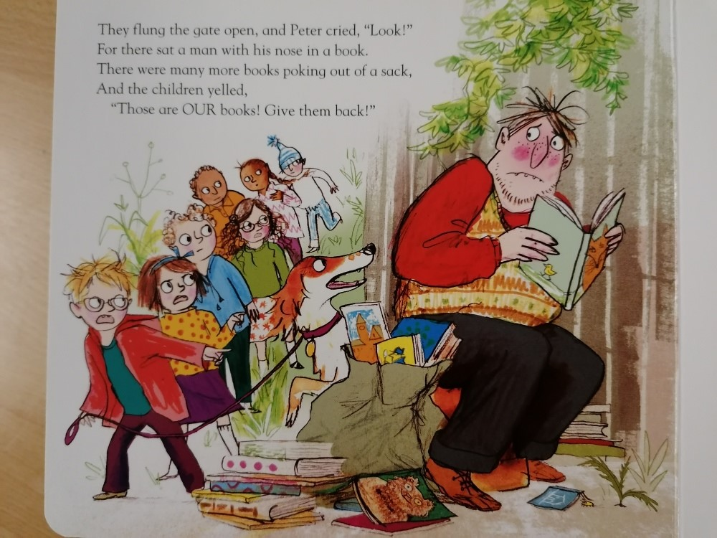


Slide 6
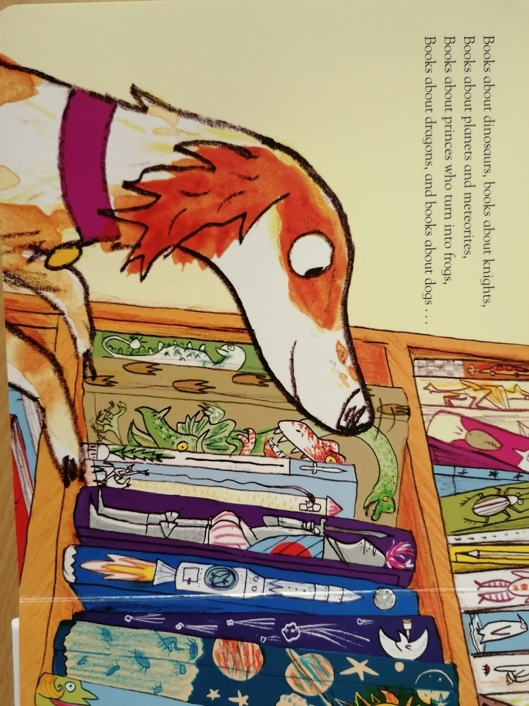


Slide 7



Slide 9
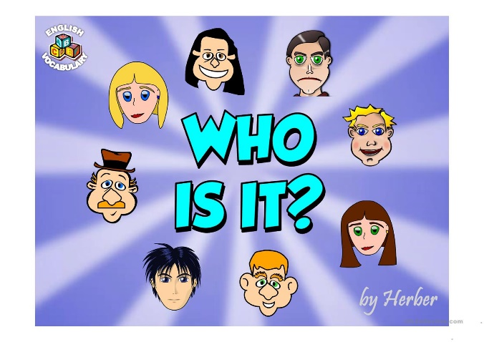

Slide 10
Everyday me and my mum walk to school
My friends think I’m funny, smart and cool!
Wolves are my favourite animal and I love how they howl
I pretend to be one, just watch me prowl!
Who am I?

Slide 11
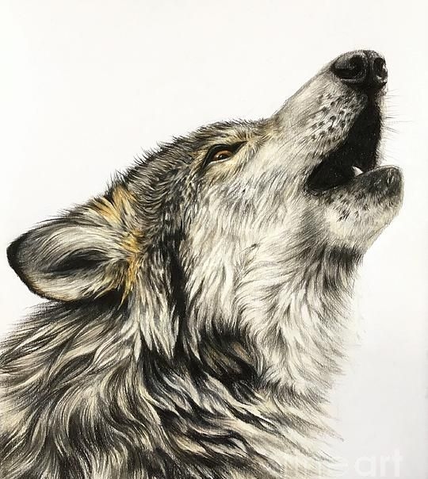
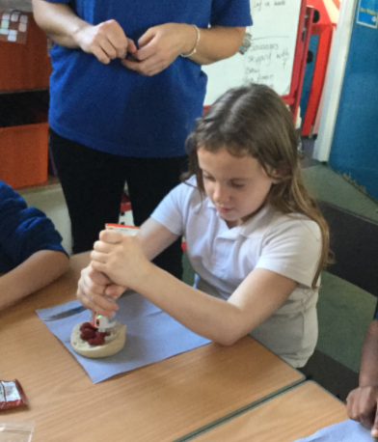

Slide 12
I am fast, strong and quick
With the ball I score, pass and flick!
I can kick, throw and catch
Pick me, and you’ll win the match!
Who am I?

Slide 13
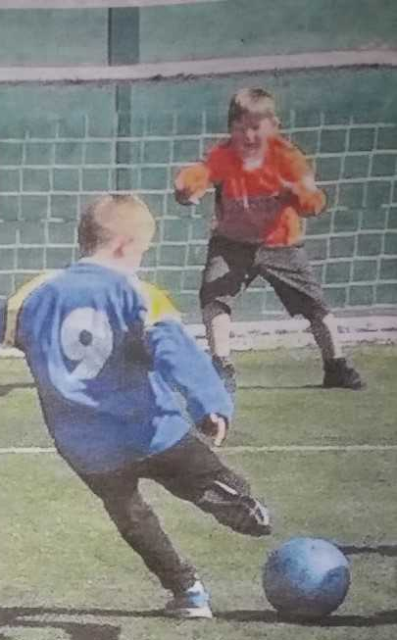
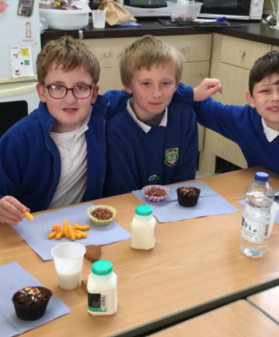

Slide 14

On the yard I love to play chase
I’m fun and happy, with a cheeky face!
I like Arthur who was a great king
On his finger he wore a gold ring
Who am I?

Slide 15
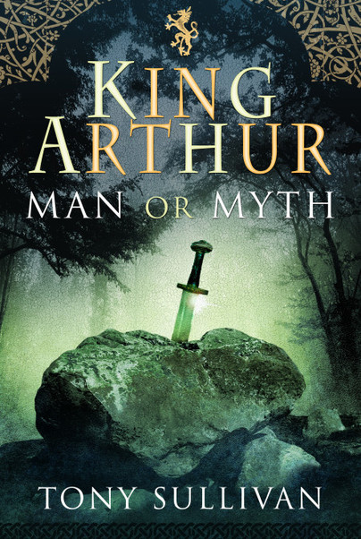
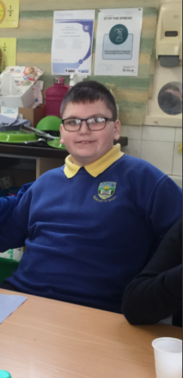

Slide 16
With my gloves, the ball I save
I jump and dive, I am very brave
My round glasses are super cool
They help me to do really well in school
Who am I?

Slide 17

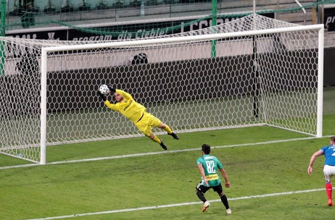

Slide 18
I am a boy with short brown hair
I am kind and gentle and I always care
I love sea animals, from whales, squid and fish
But to become a shark is what I really wish
Who am I?

Slide 19

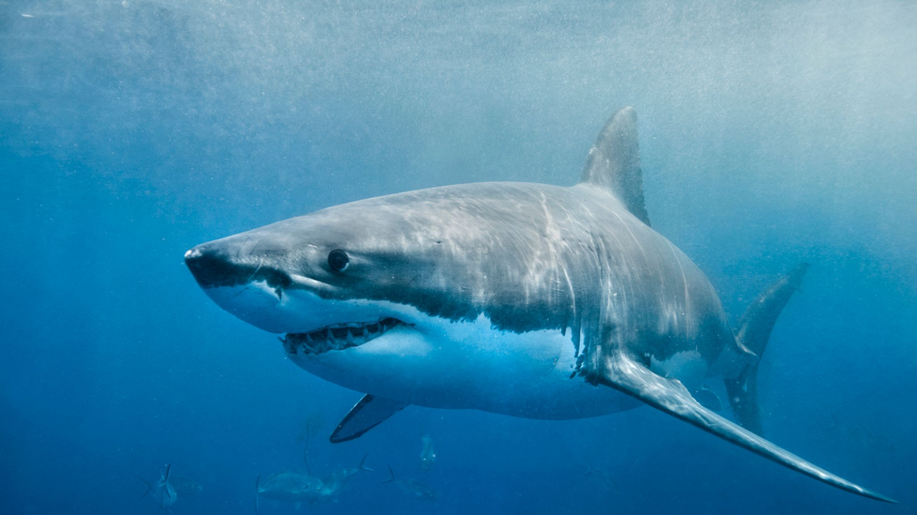

Slide 20
I’m a girl who loves LOL
They’re cute, funny and certainly don’t smell!
I am happy, friendly and I love to chatter
Me and Miss Lewis love a natter!
My sister works in the local shop
Mr Brown goes there to buy Haribos and pop!
Who am I?

Slide 21
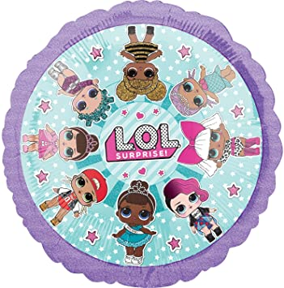
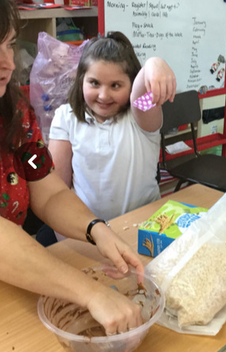

Slide 22

Mr Tumble, he makes me glad
He picks me up when I feel sad
I am a boy who loves a hoop
It makes me happy, I even whoop!
Who am I?

Slide 23
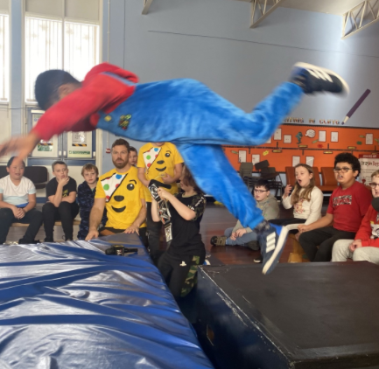
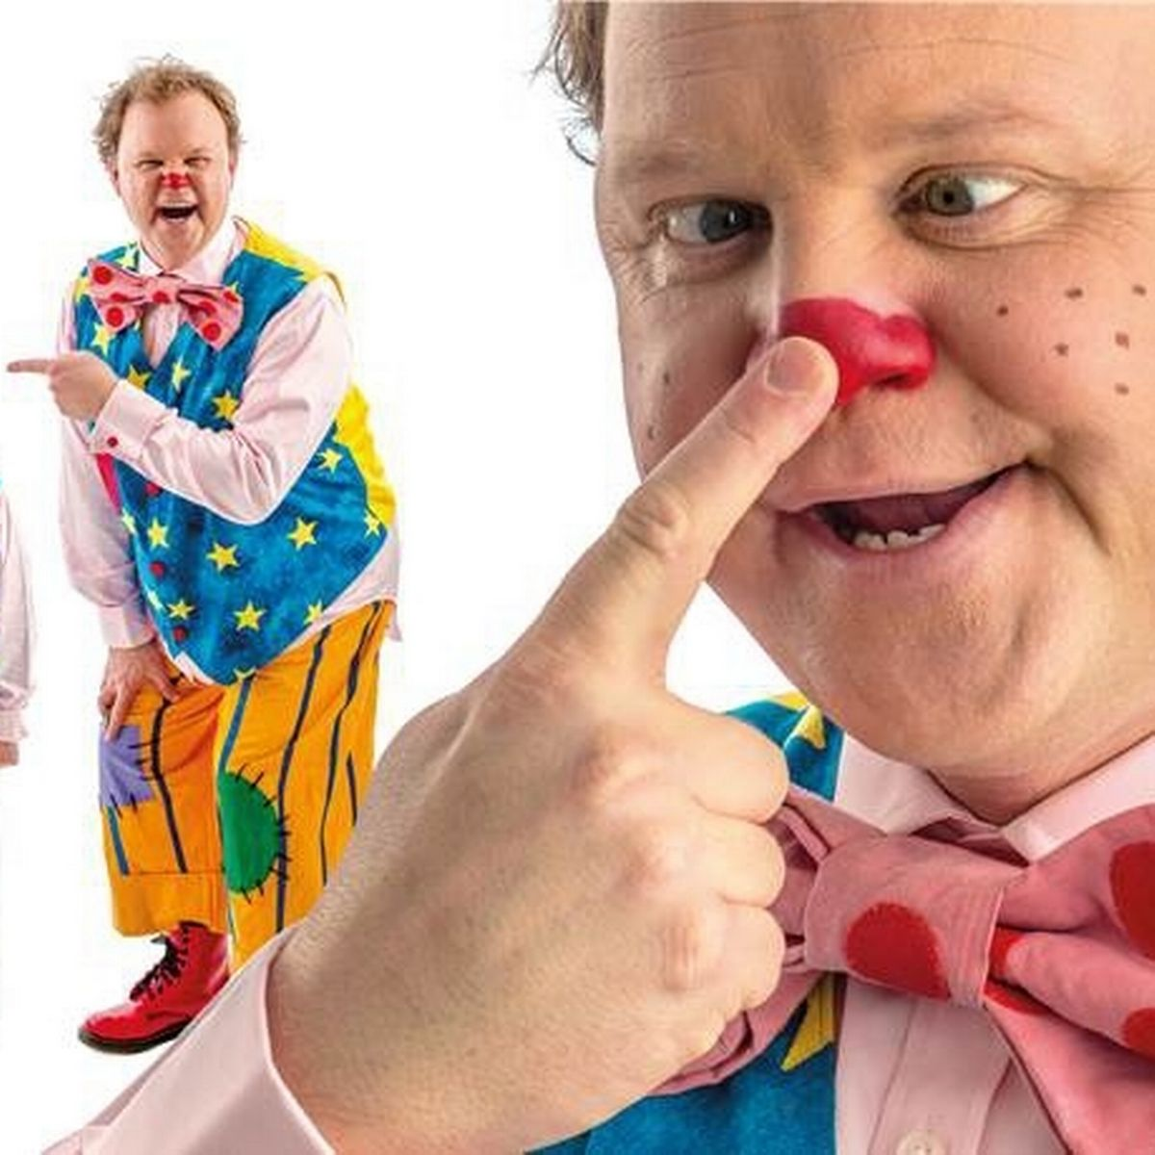

Slide 24
The hottest is star is our own sun
To learn about space is so much fun
I have a brother, Tyler is his name
We look different and yet a bit the same!
My best friend is a boy called Logan
‘Super cool boys’ should be our slogan
Who am I?

Slide 25
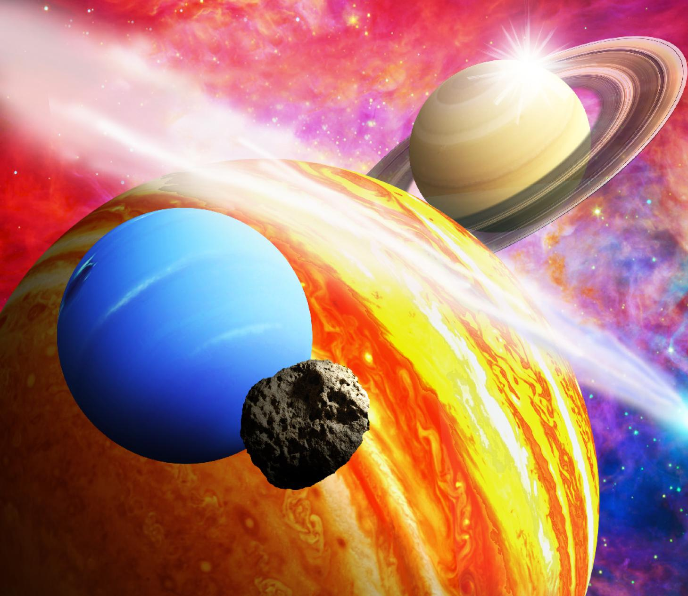
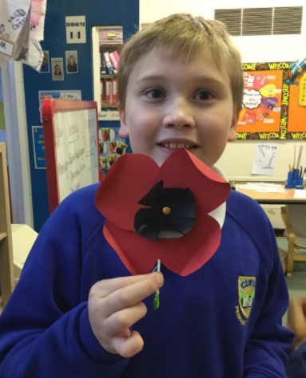

Slide 26
Back to the Future is so cool
I’d like to watch this in my school
I am a boy who’s name sounds like sack
Is it Edward, Scott, or is it …………
Who am I?

Slide 27

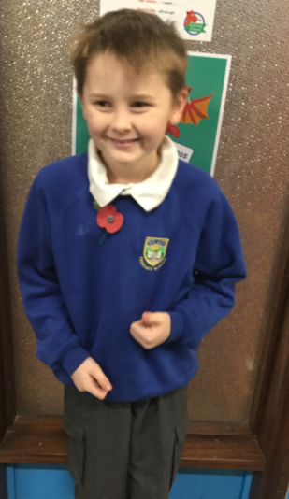

Slide 28
Ashton is a boy, who’s a best friend to me
We talk and laugh, he makes me happy
Computers and gaming are the best
I’m really good, better than the rest!
Who am I?

Slide 29



