Slide 1
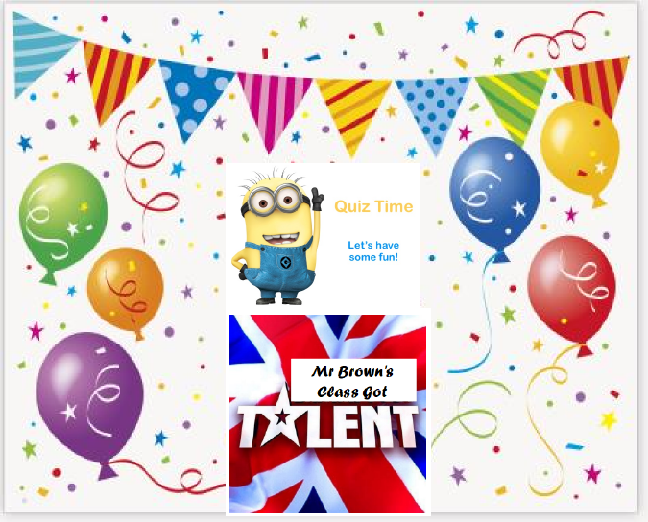

Slide 2
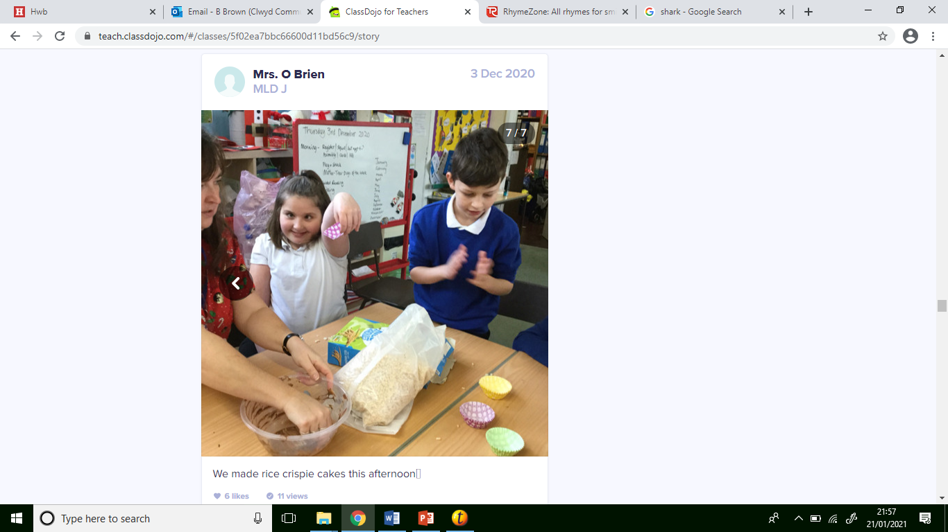

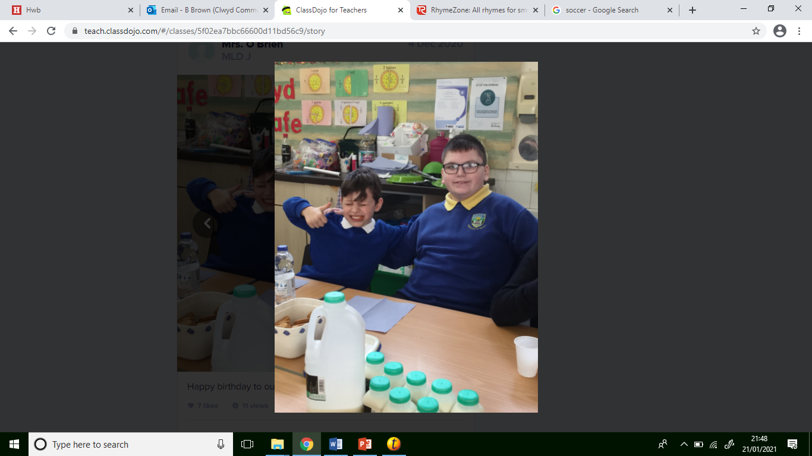
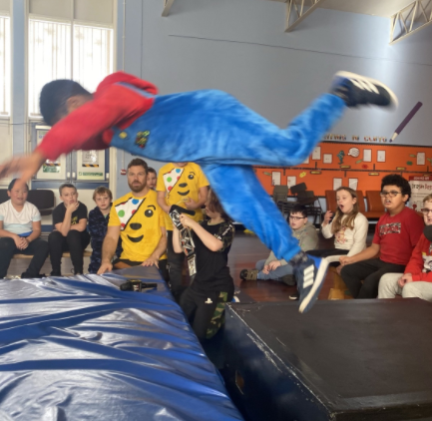
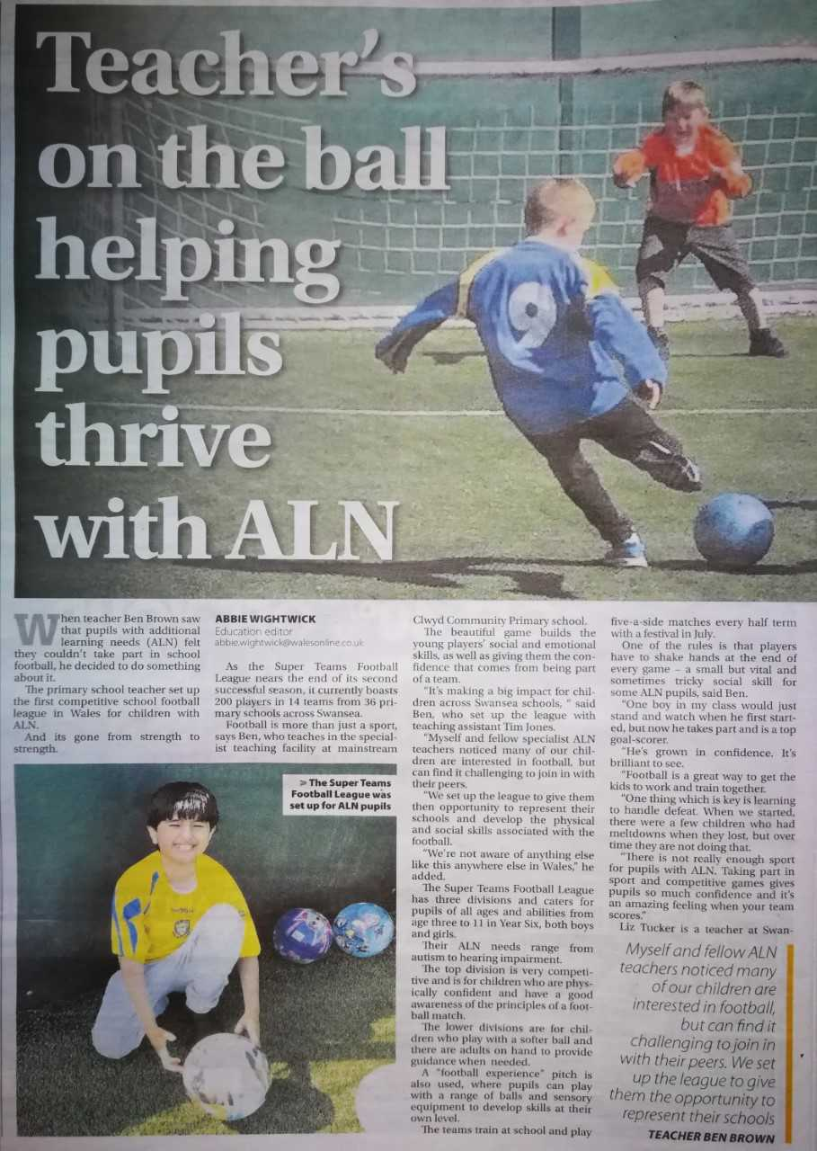
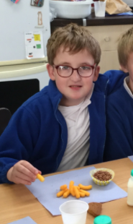

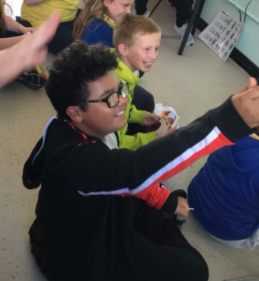
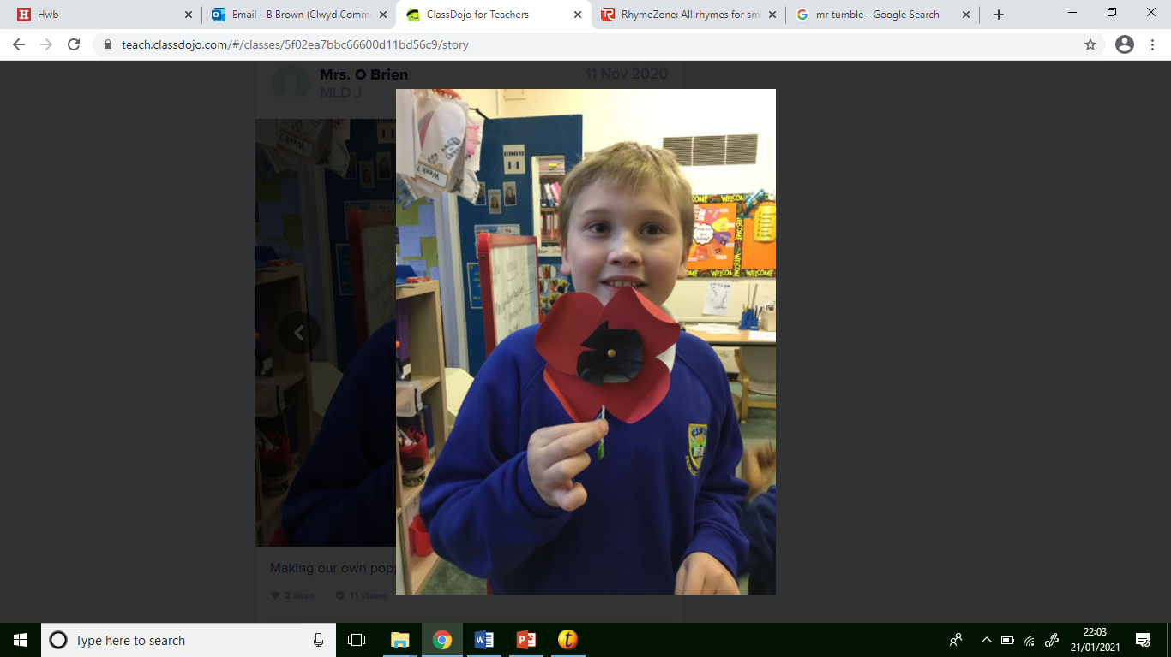
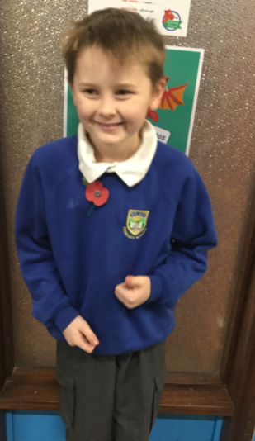
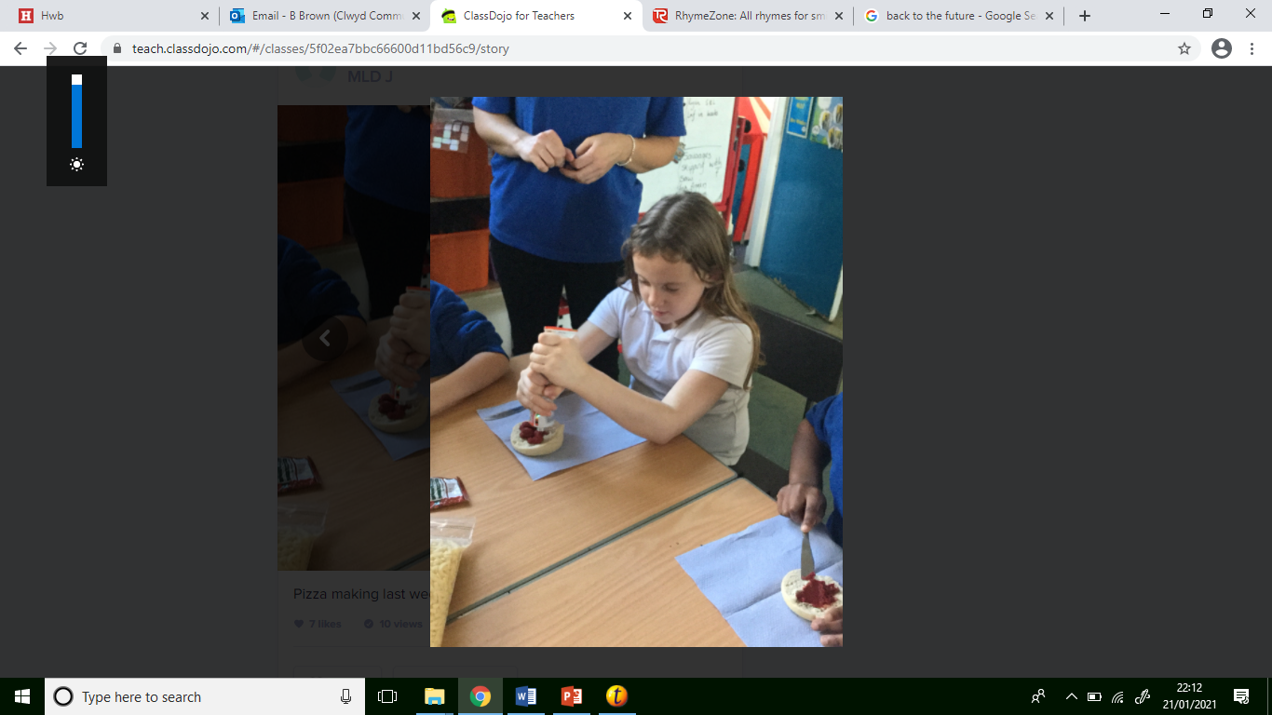

Slide 3
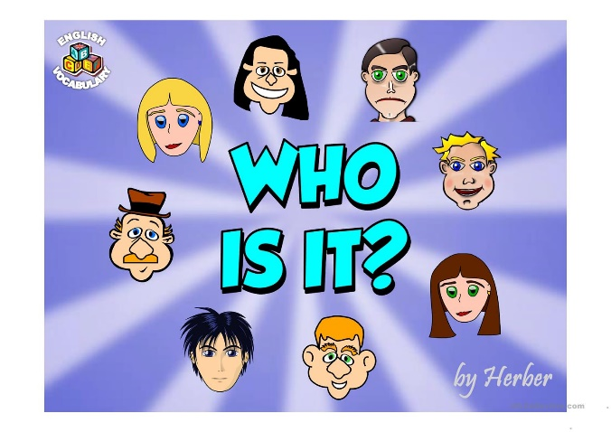
Everyday me and my mum walk to school
My friends think I’m funny, smart and cool!
Wolves are my favourite animal and I love how they howl
I pretend to be one, just watch me prowl!
Who am I?

Slide 4
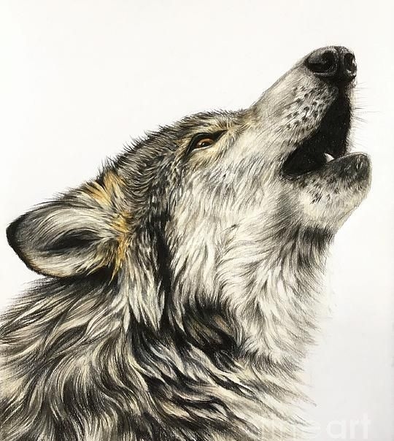

Slide 5
I am fast, strong and quick
With the ball I score, pass and flick!
I can kick, throw and catch
Pick me, and you’ll win the match!
Who am I?

Slide 6


Slide 7

On the yard I love to play chase
I’m fun and happy, with a cheeky face!
I like Arthur who was a great king
On his finger he wore a gold ring
Who am I?

Slide 8


Slide 9



Slide 10
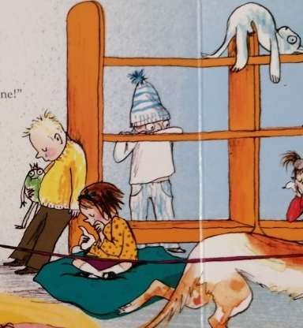
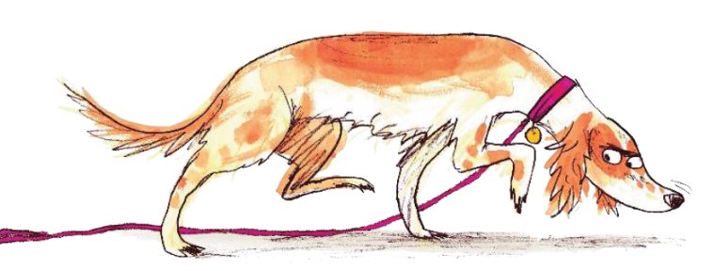
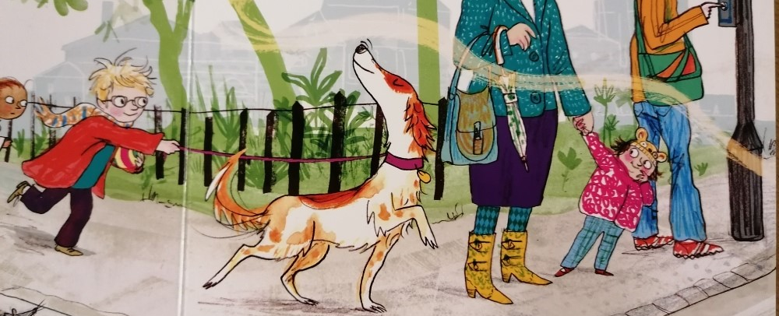
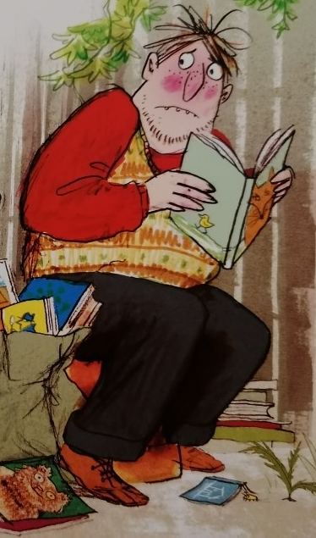

What is the name of the dog?
a) Bell
b) Nell
c) Smell
2. What was stolen from the class?
a) Books
b) Laptops
c) Toilet roll
3. What part of her body did the dog use to find the books?
a) Feet
b) Nose
c) Tail
4. How did the thief feel when he got caught?

Slide 11



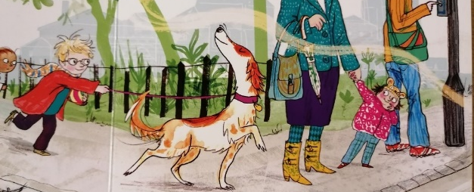
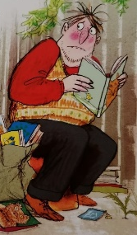
What is the name of the dog?
a) Bell
b) Nell
c) Smell
2. What was stolen from the class?
a) Books
b) Laptops
c) Toilet roll
3. What part of her body did the dog use to find the books?
a) Feet
b) Nose
c) Tail
4. How did the thief feel when he got caught?
embarrassed shocked
sad sorry ashamed

Slide 13
With my gloves, the ball I save
I jump and dive, I am very brave
My round glasses are super cool
They help me to do really well in school
Who am I?

Slide 14
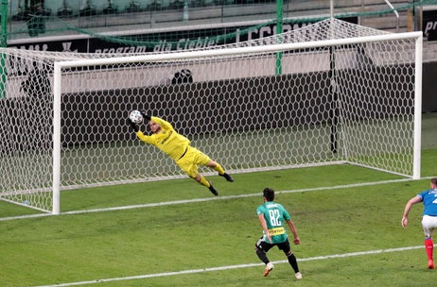

Slide 15
I am a boy with short brown hair
I am kind and gentle and I always care
I love sea animals, from whales, squid and fish
But to become a shark is what I really wish
Who am I?

Slide 16
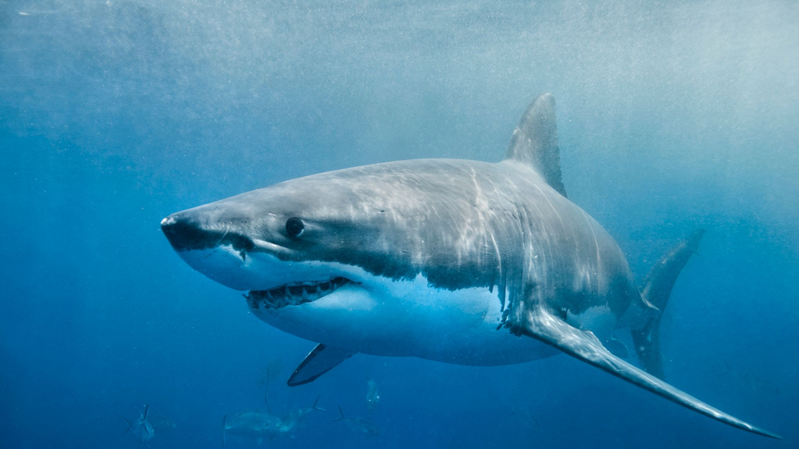

Slide 17
I’m a girl who loves LOL
They’re cute, funny and certainly don’t smell!
I am happy, friendly and I love to chatter
Me and Miss Lewis love a natter!
My sister works in the local shop
Mr Brown goes there to buy Haribos and pop!
Who am I?

Slide 18


Slide 19


Slide 20
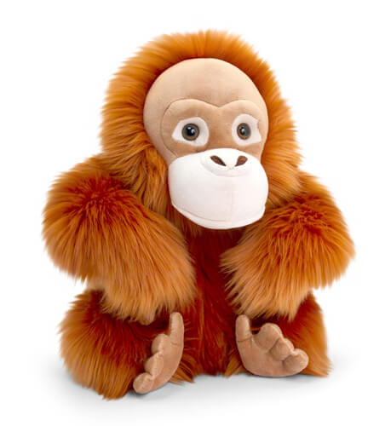

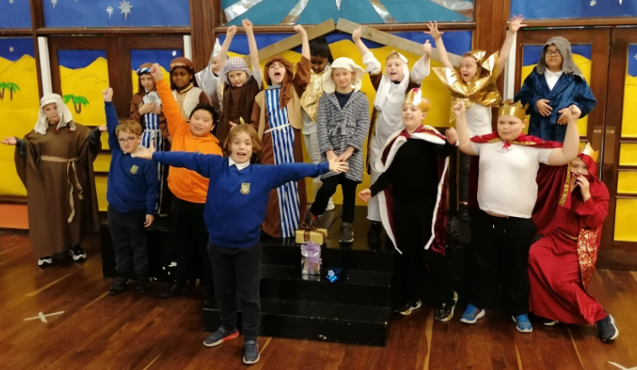

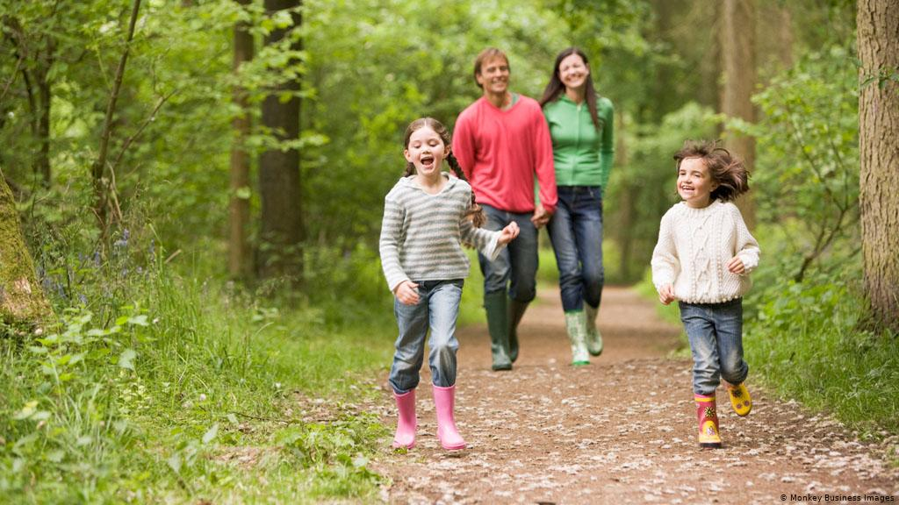
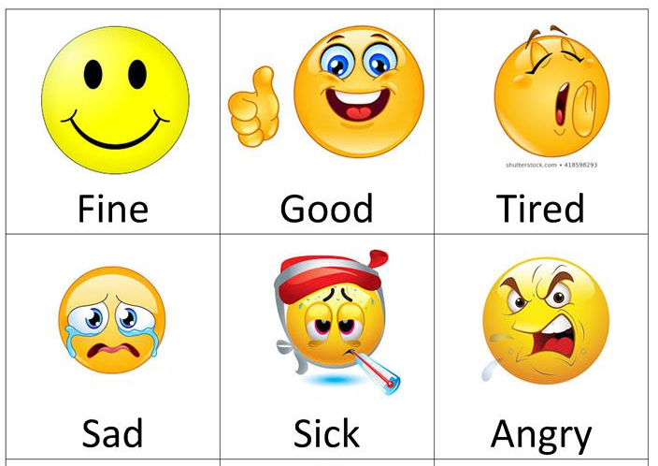
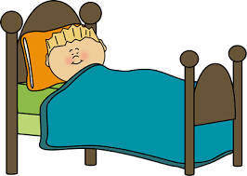
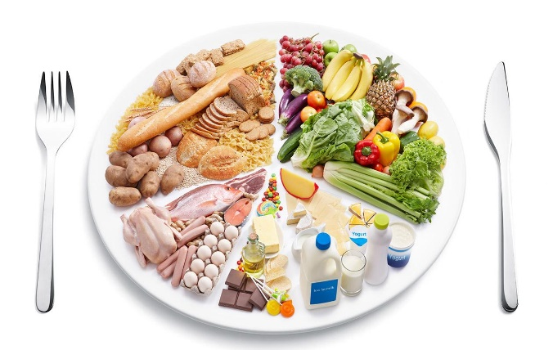

Slide 21
Question 6
Question 7
Question 5

Slide 22

6. Friends
7. Feelings
5. Sleep

Slide 23

Mr Tumble, he makes me glad
He picks me up when I feel sad
I am a boy who loves a hoop
It makes me happy, I even whoop!
Who am I?

Slide 25
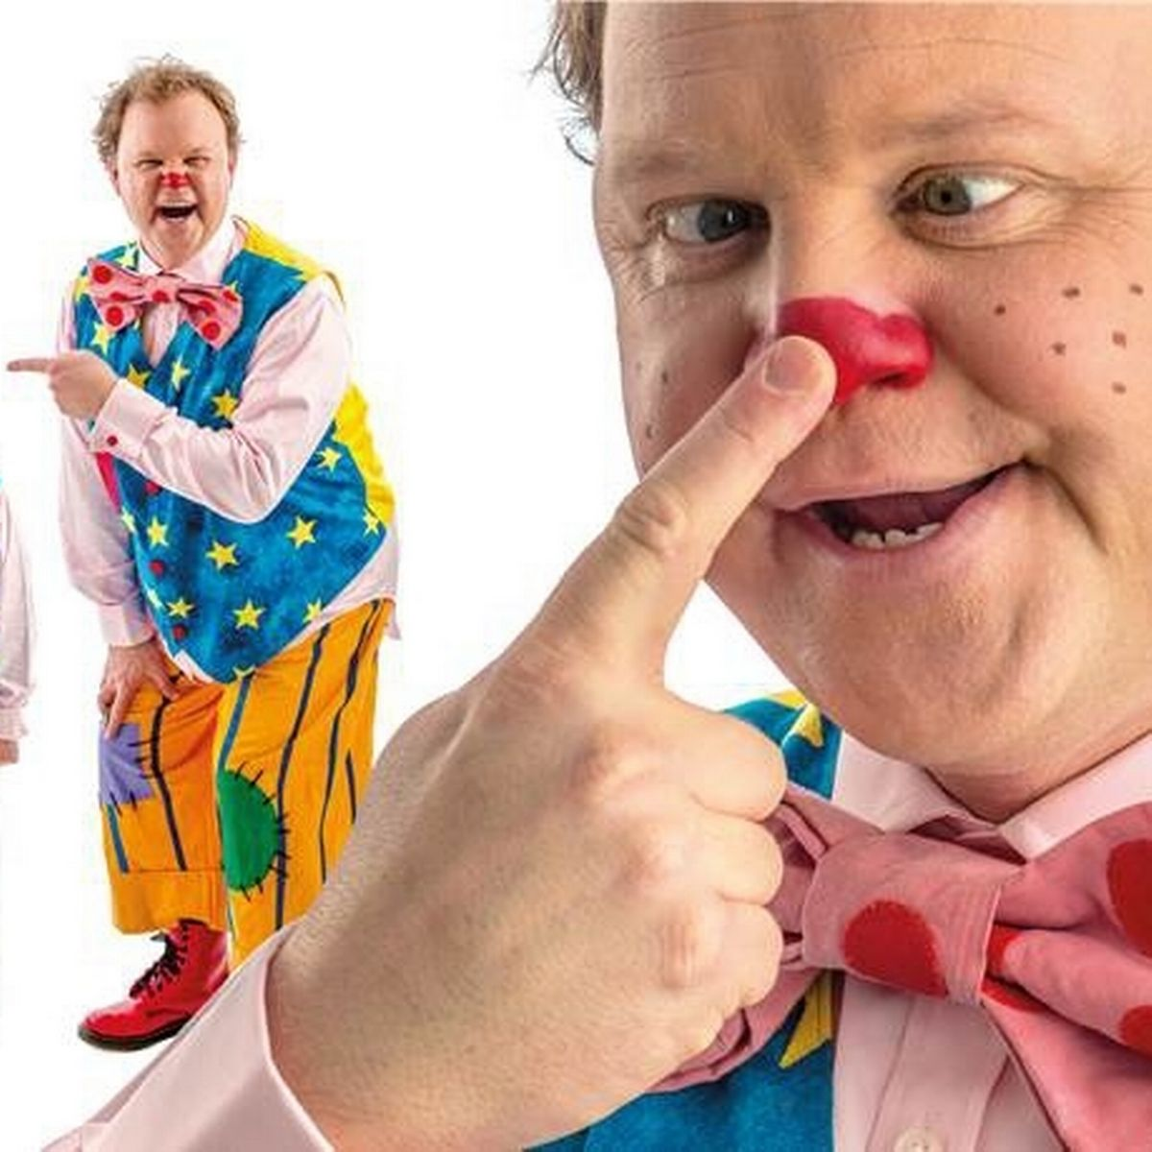

Slide 26
The hottest is star is our own sun
To learn about space is so much fun
I have a brother, Tyler is his name
We look different and yet a bit the same!
My best friend is a boy called Logan
‘Super cool boys’ should be our slogan
Who am I?

Slide 27
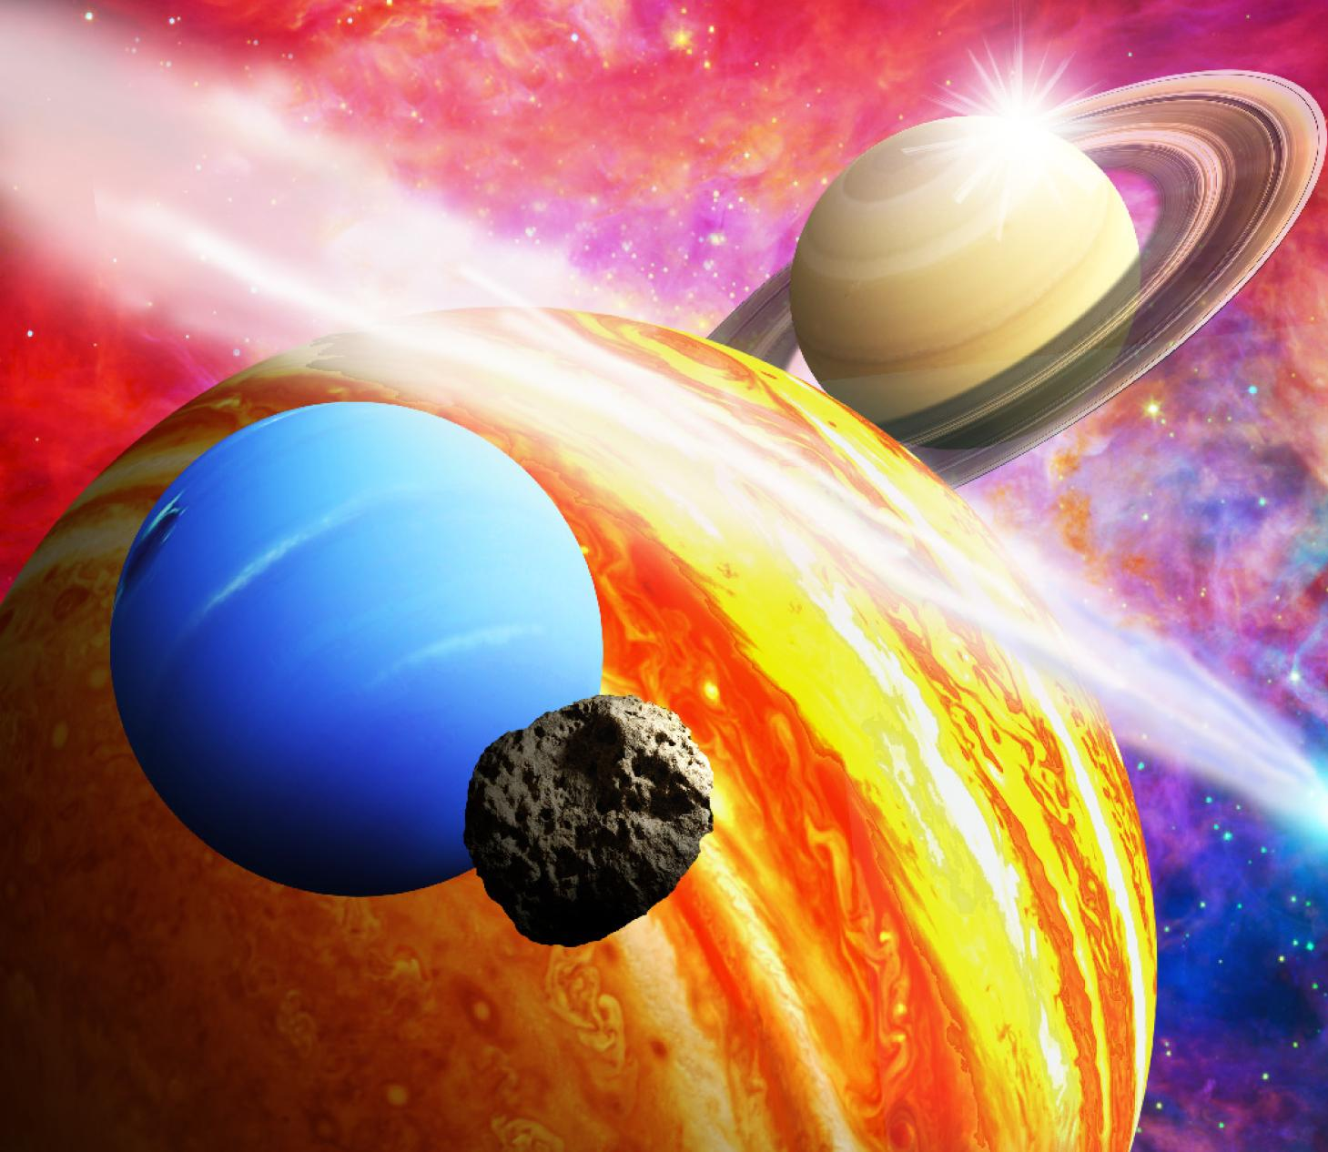

Slide 28
Back to the Future is so cool
I’d like to watch this in my school
I am a boy who’s name sounds like sack
Is it Edward, Scott, or is it …………
Who am I?

Slide 29


Slide 30


Slide 31
Ashton is a boy, who’s a best friend to me
We talk and laugh, he makes me happy
Computers and gaming are the best
I’m really good, better than the rest!
Who am I?

Slide 32


Slide 33
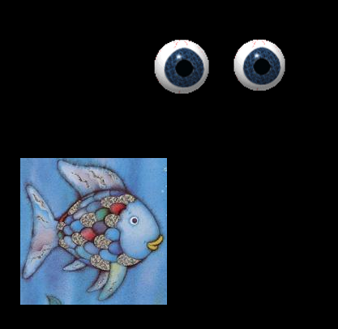

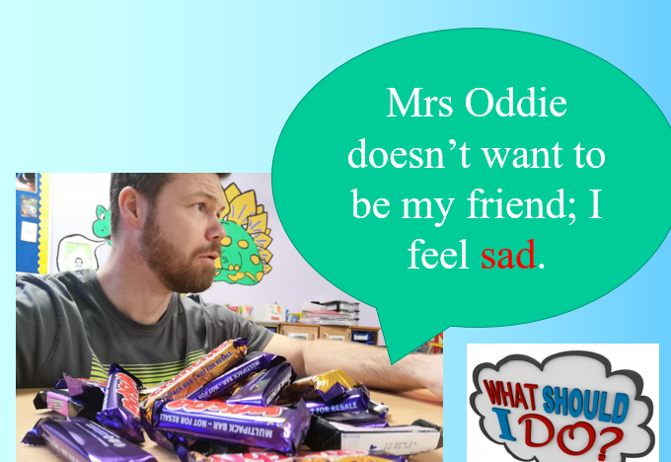
8. What animal was hiding in the cave?
9. In the end the Rainbow Fish shared. What did he share?
Whale
Shark
Octopus
His scales
His Pokémon toys
His McDonald's
10. What should I do?
Keep them for me
Share
Find a new friend

Slide 34

8. What animal was hiding in the cave?
9. In the end the Rainbow Fish shared. What did he share??
Whale
Shark
Octopus
His scales
His Pokémon toys
His McDonald's
10. What should I do?
Keep them for me
Share
Find a new friend

Slide 35


