Slide 1


Slide 2
CLUES
4 legs
Long neck
Eats leaves
Very tall
Orange

Slide 3
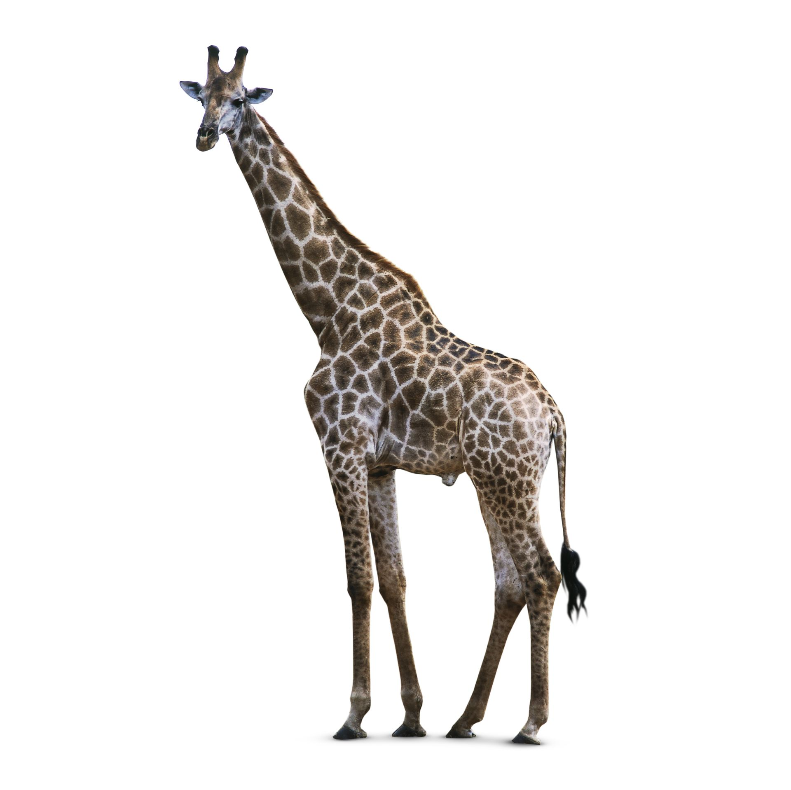

Slide 4
CLUES
No legs
Moves on the ground
Some have poison

Slide 5
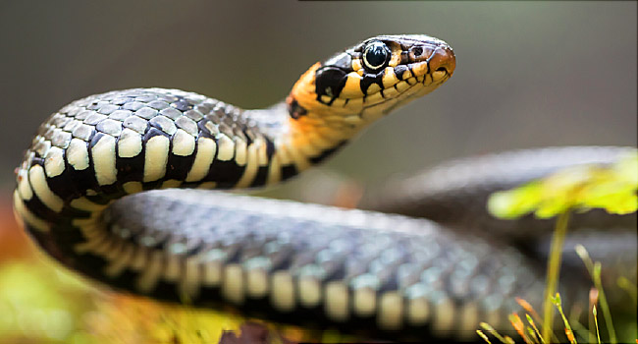

Slide 6
CLUES
Heavy
4 legs
Grey
Big ears

Slide 7
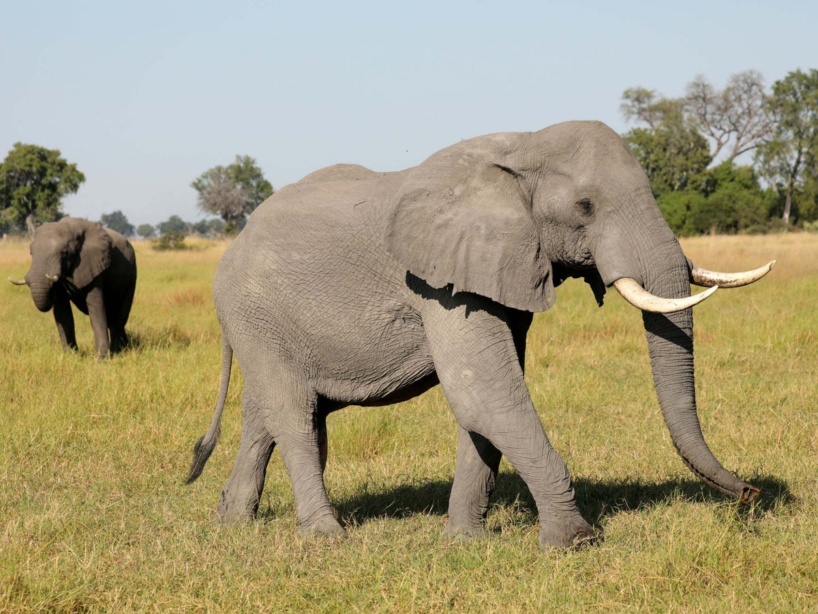

Slide 8
CLUES
Sharp teeth
Extinct
Scary
Little arms
Tail
Kai loves these!

Slide 9
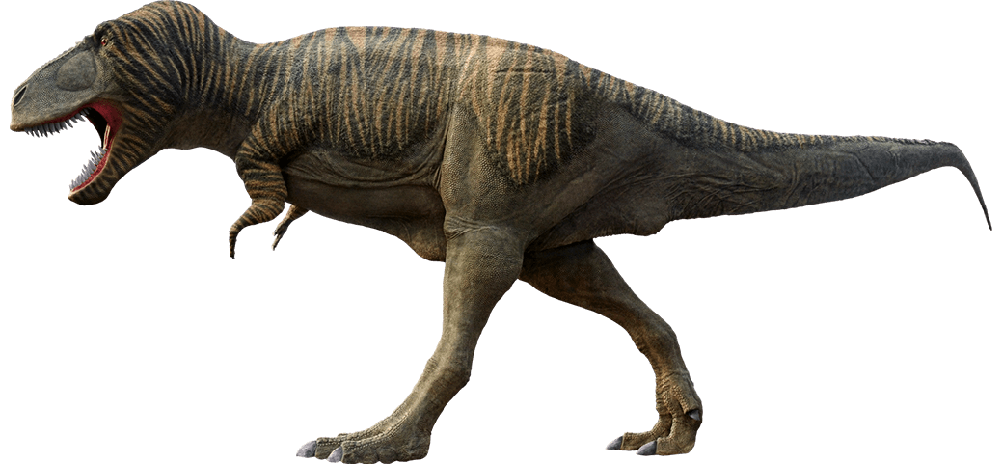

Slide 10
CLUES
4 legs
Tail
Looks like a horse
Black and white stripes

Slide 11
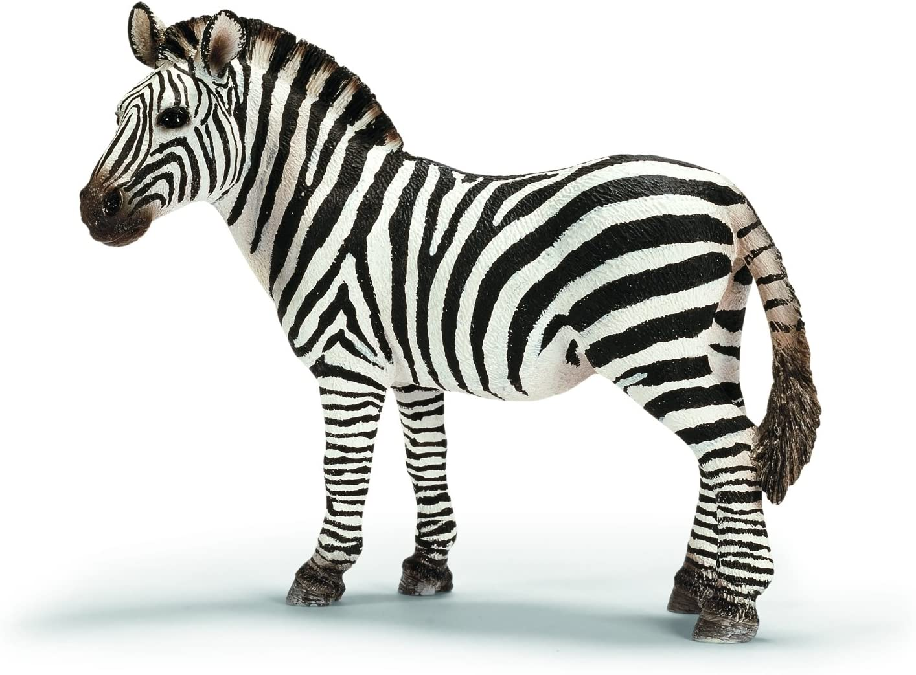

Slide 12
CLUES
8 legs
Small
Makes webs

Slide 13
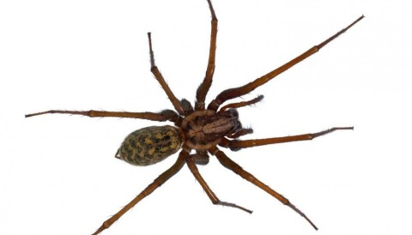

Slide 14
CLUES
Year 5
Tall
Boy
Black hair
Made the game ‘Mr Bean’s Silly Sausages’

Slide 15
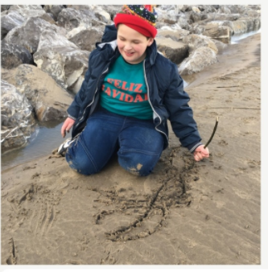

Slide 16
CLUES
Boy
Loves McDonald's
Runs fast
Made the game Super Mario Tag!

Slide 17
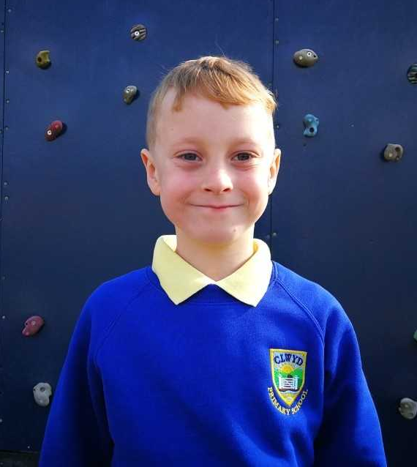

Slide 18
CLUES
Woman
Works in Mr Brown’s Class
Loves dogs!
Has a dog called Doug
Is getting married this year
Black hair

Slide 19
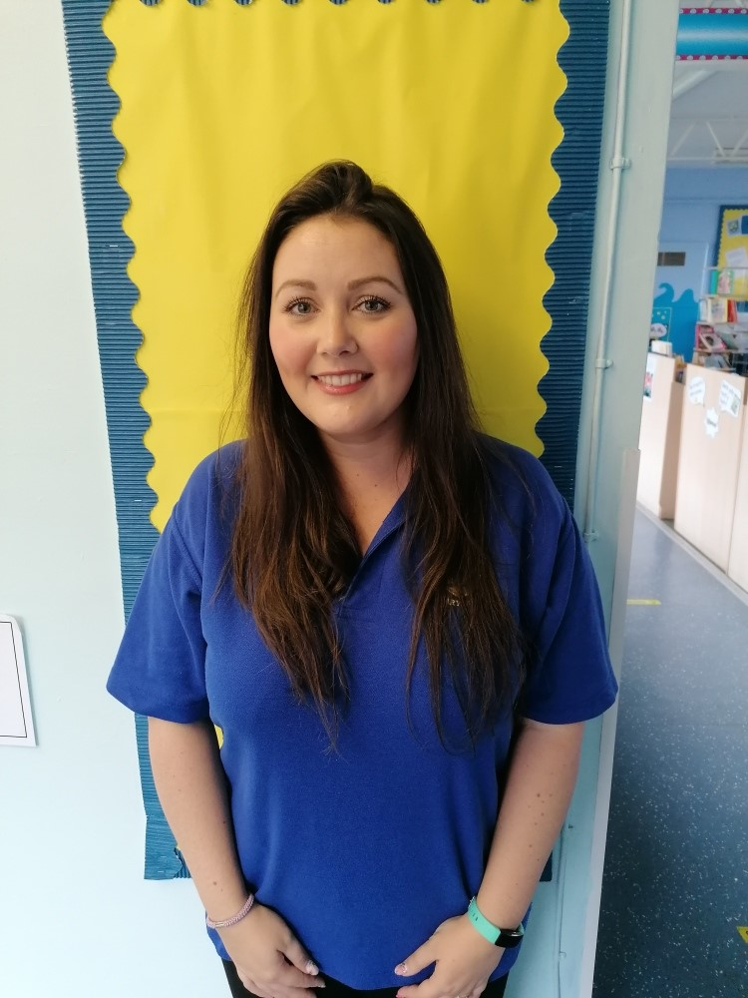

Slide 20
CLUES
I am a cat
I am on a cartoon
I am always try and get a mouse
I often hurt myself as I try and get the mouse!

Slide 21


