Slide 1
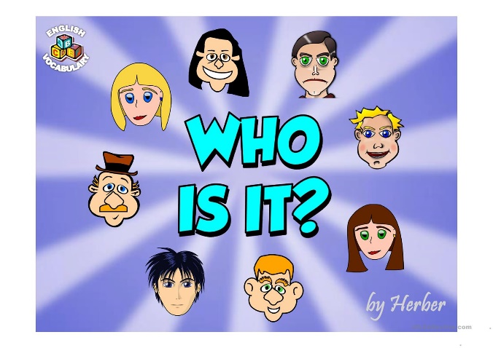

Slide 2
I am a fast and strong boy
and I love playing with Jeffy, my cool toy
As a wrestler, The Rock is the best
Like my dad, he has a super strong chest!
For my birthday I wrestled on a mat
I jumped on Tyrese’s back and made him flat!

Slide 3
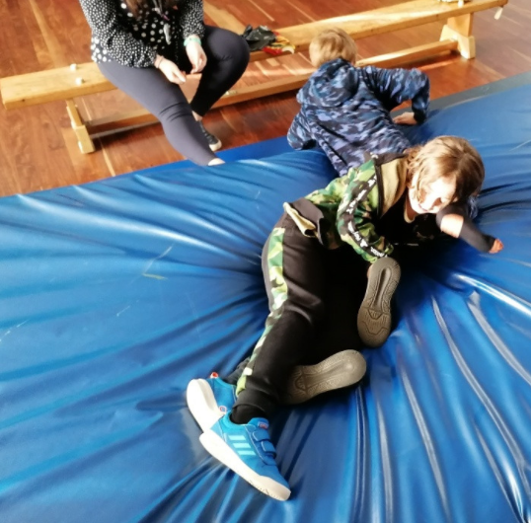
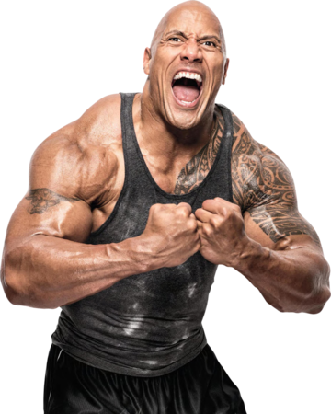

Slide 4
Anything pink I just love
especially pink soap made by Dove
In cooking time I love to bake
especially icing a soft delicious cake
In the class, as a girl, it’s only me
Miss John said ‘girls are the best’, and I kind of agree!

Slide 5
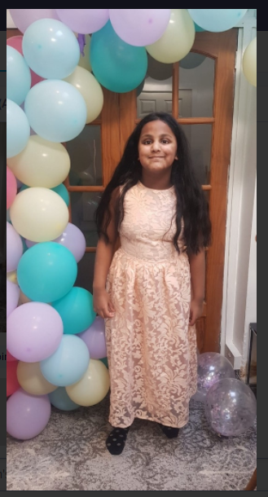

Slide 6

I go to a school called Clwyd
so does my super cool brother called Floyd
I’m as happy as can be
When I’m watching Toy Story 3
I love Mr Bean as he talks in a funny voice
I'd speak like him given a choice!

Slide 7
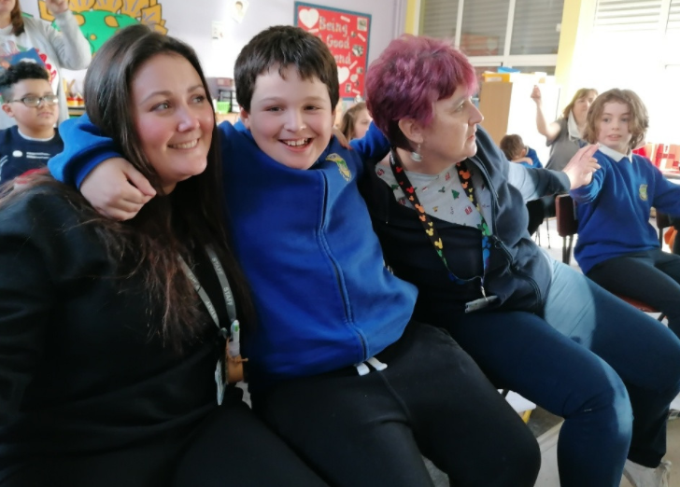

Slide 8
I love to go outside and camp
with my marshmallows, fire and lamp
My brothers are Jacob and Freddy
and when I get to school, I’m always ready
When it comes to drawing, I’m so good
To draw like me, Mr Brown wishes he could!

Slide 9
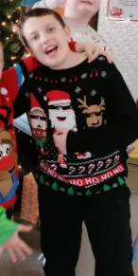
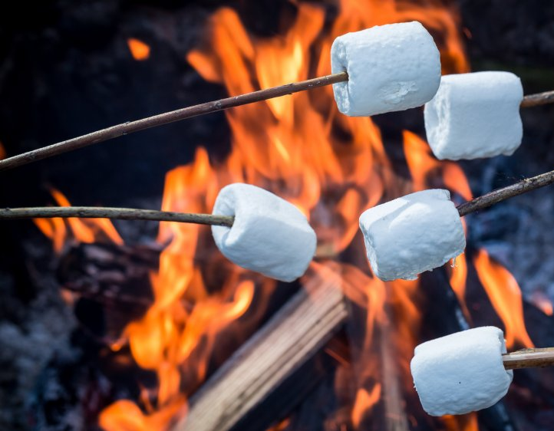

Slide 10
I am funny, well mannered and kind
Friends like me are good to find
I come to school in a black taxi
Sitting with Logan and Ashleigh
Dominoes, Pizza Hut, McDonald’s and more
When I see a Big Mac my mouth drops to the floor!

Slide 11
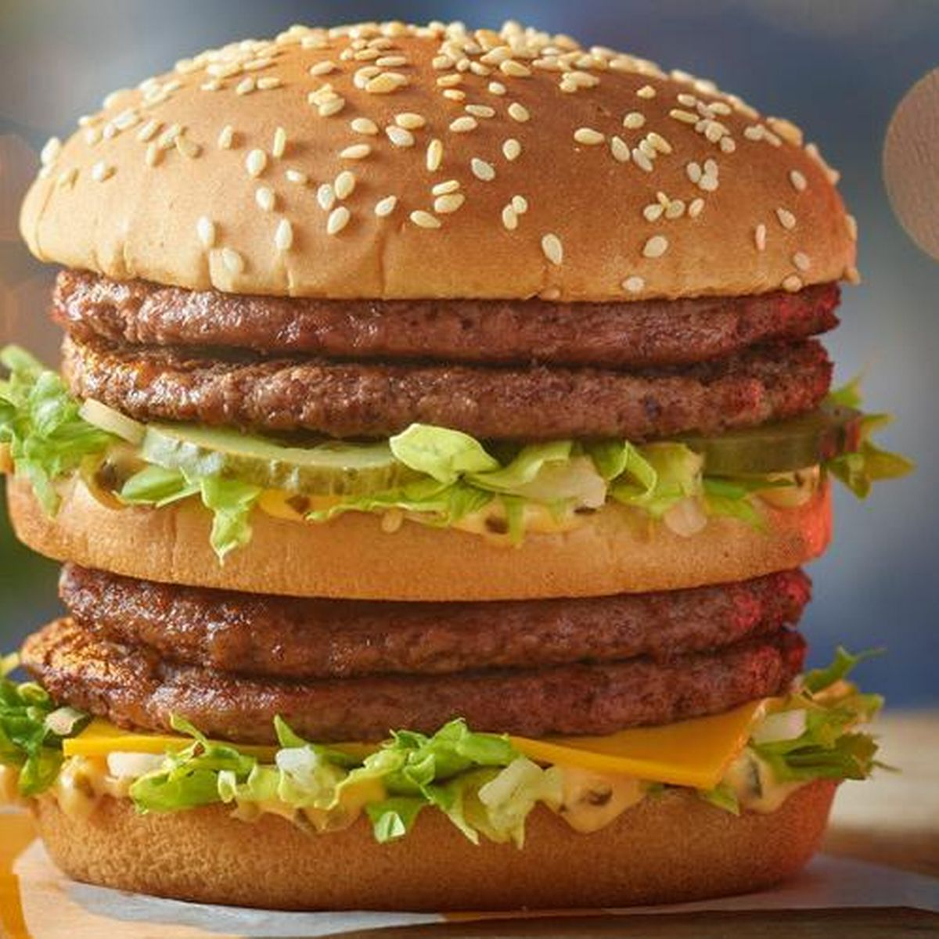
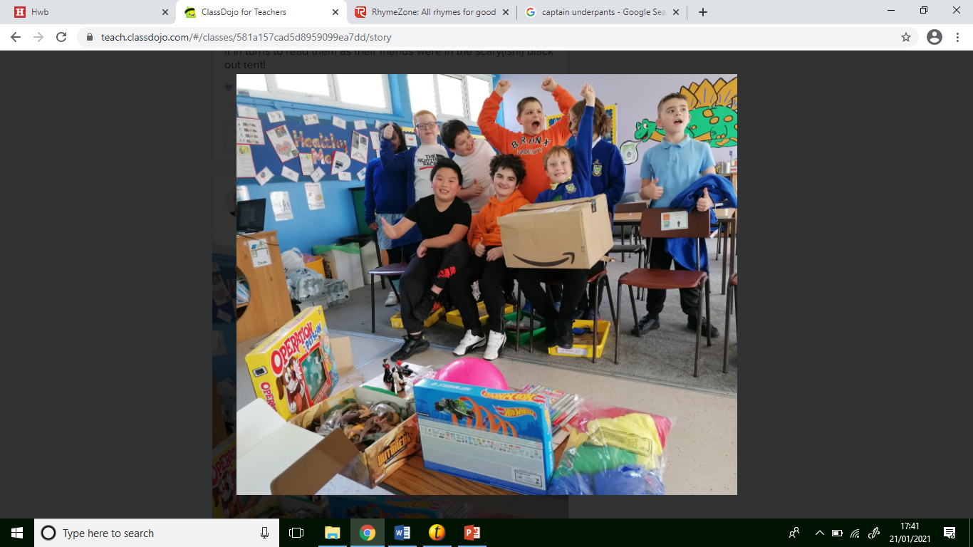
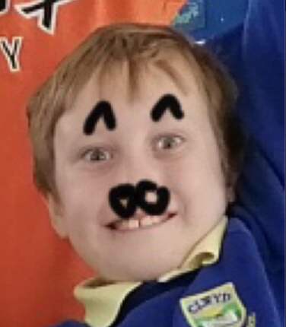

Slide 12
Please and thank you, I always say
To be like this, that’s the way
Brachiosaurus are cool as they have really long necks
But there’s only one dinosaur for me and that’s a T-Rex!
They have super strong jaws
and I love the sound of their ROARS!

Slide 13
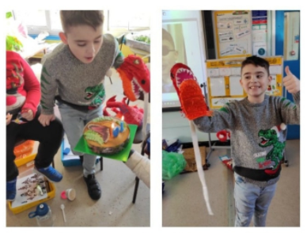
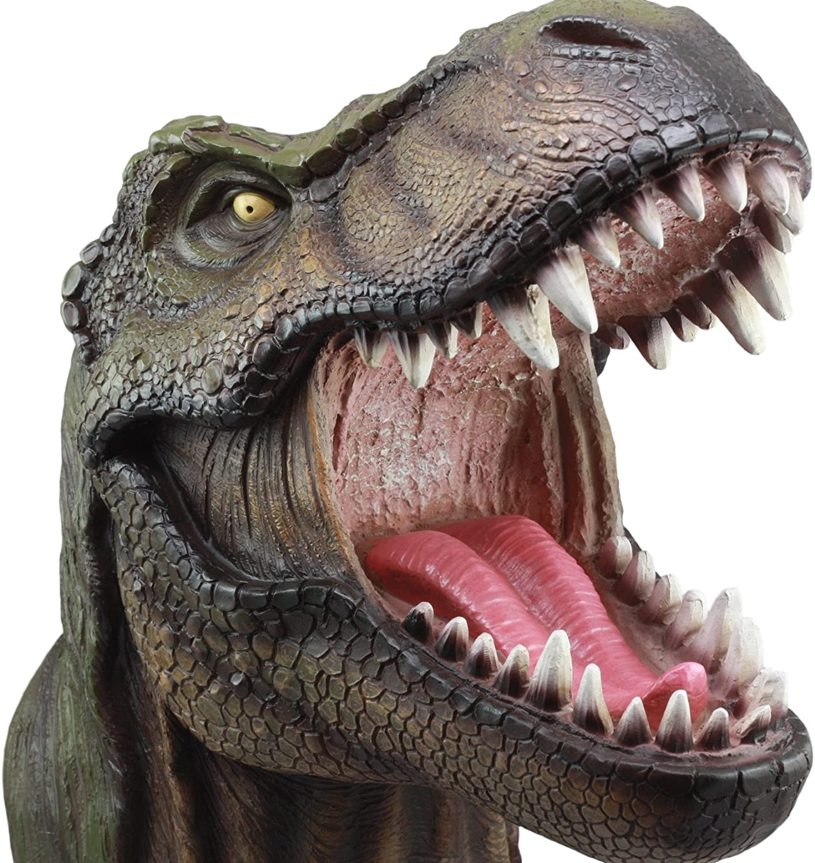

Slide 14

I am amazing at drawing, I’m so cool
I am one of the best in the whole entire school!
I’m good at Number, shape, adding and more
I even know that 2 add 2 is 4!
With my brother Johnny I live in Blaenymaes
We live above a Chinese restaurant, the food is so nice

Slide 15
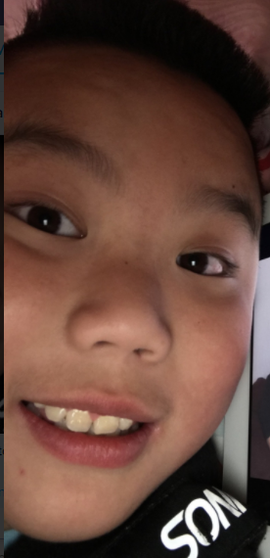
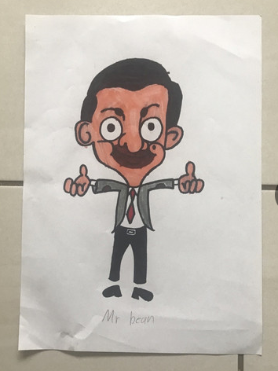
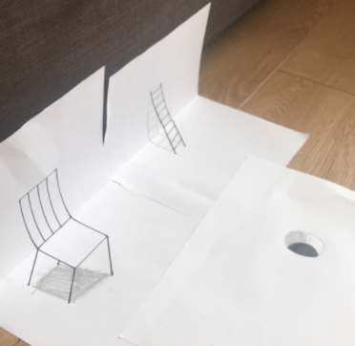

Slide 16
I come in a big red van to school
It has 10 seats and it’s super cool!
Dogs, cats, horses and more
I have lots of animals which I adore
Guess what, Roblox is what I love to play
And I’d play it all day if I had my way!

Slide 17
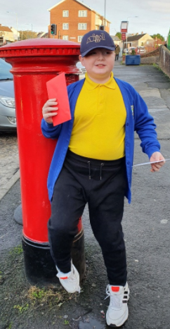


Slide 18
I’m in Year 6 and I wear an orange hoodie
I have lots of friends, but Kai is my newest buddy
Last summer I became a big brother
4 children have my father and mother!
I like to go outside and play Pokémon Go!
To catch a Pokémon, you can’t be slow!

Slide 19

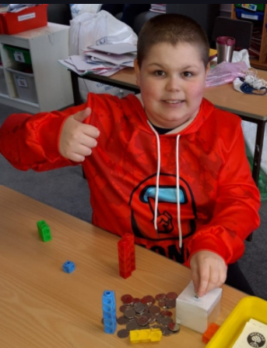

Slide 20
My clothes are cool and I have a good style
I’m a kind, gentle boy with a lovely smile
I’m good at football, like Ronaldinho
When I play, Mr Brown shouts ‘Go Iestyno!’

Slide 21


